Slide 1
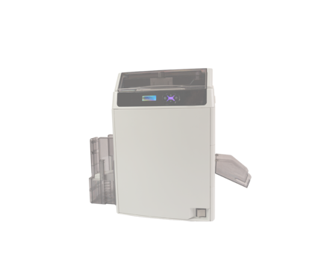
How to print S panel (Rtai LUKA-40KM)
- It is explained in English version.
- Selecting buttons at the same location
when installing other languages
December 10, 2020

Slide 2
1. Select card size (step-1)

Slide 3
1. Select card size (step-2)

Slide 4
2. Select overlay type

Slide 5
3. Select print image & sizing (Content)

Slide 6
4. Select print image & sizing (S overlay)

Slide 7
5. Fine-tune location and size (S overlay same operation)

Slide 8
6. Select a printer and set output options
2. Turn off the back printed layer option when printing a section

